Slide 1
NOTICE
HS 513

Slide 2
NOTICE
A written or printed announcement or communication that conveys information, instructions, or notifications to a specific individual, group, or the public at large
Typically used in various contexts and settings to convey important messages or provide information
It can be formal or informal
It can be pasted on notice boards.
Published in a newspaper
The government, when it issues notices, must publish it in national and local papers.

Slide 3
PURPOSE
Legal Notices: These are formal notifications issued by government authorities or legal entities to inform individuals or the public about legal matters such as court proceedings, public hearings, foreclosures, and legal judgments.
Public Notices: Public notices are typically issued by government agencies or institutions to inform the public about important matters such as changes in laws and regulations, public meetings, zoning changes, and public safety alerts.

Slide 4
PURPOSE
Employee Notices: Employers use notices to communicate with their employees about workplace policies, benefits, upcoming events, and other work-related matters. These notices can be posted in the workplace or distributed electronically.
School Notices: Schools and educational institutions often use notices to inform students, parents, and staff about important dates, events, school policies, and academic information.

Slide 5
PURPOSE
Notices of Intent: In various contexts, individuals or organizations may issue notices of intent to inform others of their intention to take specific actions, such as terminating a contract, starting a legal process, or making a significant change in operations.
Eviction Notices: Landlords use eviction notices to formally inform tenants that they must vacate a rental property due to lease violations, non-payment of rent, or other reasons specified in the lease agreement or local laws.

Slide 6
PURPOSE
Notices of Intent: In various contexts, individuals or organizations may issue notices of intent to inform others of their intention to take specific actions, such as terminating a contract, starting a legal process, or making a significant change in operations.
Eviction Notices: Landlords use eviction notices to formally inform tenants that they must vacate a rental property due to lease violations, non-payment of rent, or other reasons specified in the lease agreement or local laws.

Slide 7
PURPOSE
Meeting Notices: Organizations and groups issue meeting notices to inform members or participants about upcoming meetings, including details such as the date, time, location, and agenda.
Event Notices: Event organizers use notices to promote and provide information about upcoming events, including concerts, conferences, workshops, and community gatherings.

Slide 8
HOW TO WRITE ONE
Determine the Purpose: Clearly understand the purpose of the notice. Is it an official announcement or formal communication?
Choose the Appropriate Format: The format of a formal notice typically includes the following elements:
Heading: Include your organization's name or letterhead at the top. If it's a personal notice, use your full name and contact information.
Date: Place the date on which the notice is being issued.
Recipient's Information: Include the recipient's name, title (if applicable), and contact information.
Salutation: Begin the notice with a formal salutation, such as “Dear Sir/Madam”

Slide 9
Compose the Body of the Notice
Opening Statement: State the reason for the notice
Details: Provide all relevant details, including dates, times, locations, and any specific instructions or information required by the recipient.
The Five Ws: what, where, when, who, whom
Clarity: Ensure that the language used is clear, concise, and easy to understand. Avoid jargon or technical terms.
Politeness: Maintain a polite and professional tone throughout the notice. Avoid using aggressive or confrontational language.

Slide 10
CLOSING STATEMENT
Summarize the main points.
Contact Information: Provide contact details for inquiries or additional information.
Complimentary Close: Use a formal closing, such as "Sincerely," followed by your name (or the name and title of the issuing authority).
Signature and Authorization: If the notice is on behalf of an organization or authority, ensure that it includes the appropriate signature and authorization. This may include the signature of a responsible official or the organization's seal.

Slide 11
KEEP IN MIND…
Use passive voice as far as possible
Carefully proofread
Ensure all information is accurate
Determining the method of distribution is important
Keep copies of the notice for your records

Slide 12
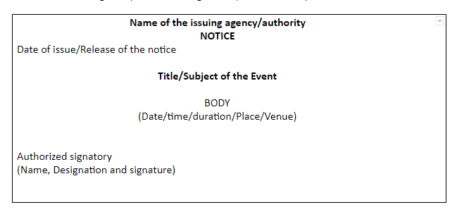

Slide 13
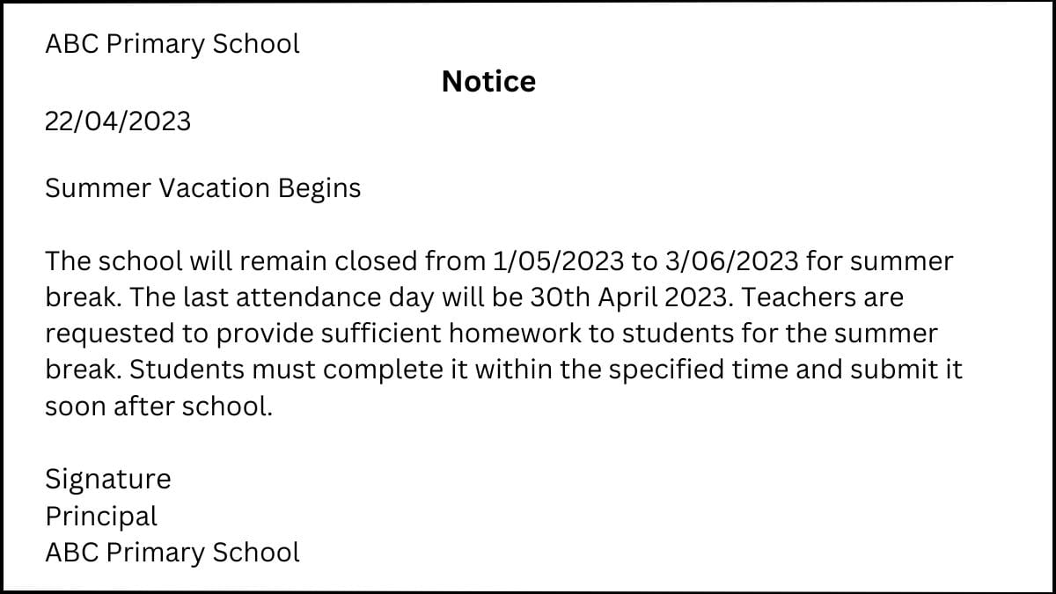

Slide 14


Slide 15
AGENDA
An agenda lists the items of business to be taken up during a meeting or session.
It may also be called a "calendar".
the items on the agenda are also known as the orders of the day.
Optimally, the agenda is distributed to a meeting's participants prior to the meeting, so that they will be aware of the subjects to be discussed, and are able to prepare for the meeting accordingly.

Slide 16
Agenda….
The simplest agendas are formatted as a short bulleted list.
More complicated agendas may include detailed descriptions, including the expected outcomes for each item, and reference material such as reports and proposals for review prior to the meeting.
Formal agendas will also include timing and presenter information for each agenda item.

Slide 17
Types
Business Agenda: used during business meeting or presentation
Event Agenda: events such as convocation, grand celebration
Weekly Agenda: for office workers/ organizational staff – to-do list
Meeting Agenda: most common – board meetings, weekly meetings, includes list of topics and sequence of planned activities
Conference Agenda: list of activities to be discussed during a conference – lets delegates know what to expect during the session

Slide 18
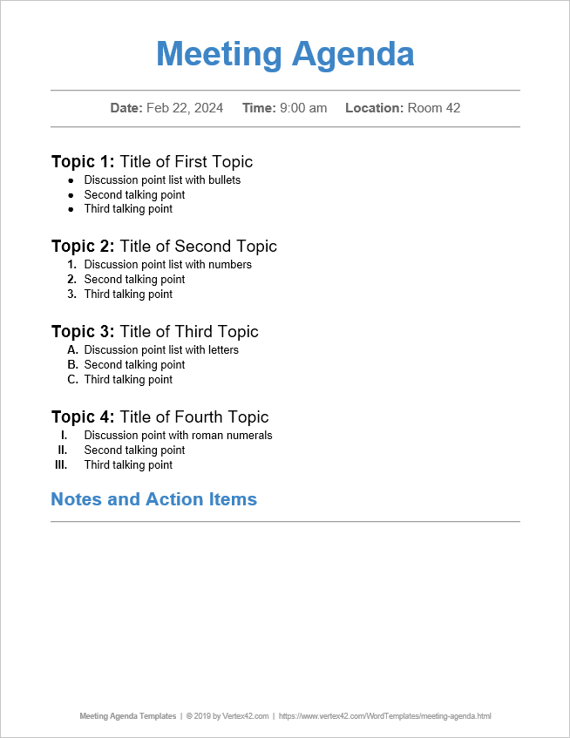

Slide 19
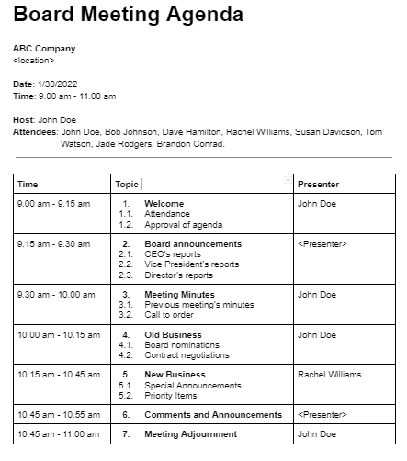

Slide 20
